Slide 1
Polynomial Regression Model Lab – Part 2

Slide 2
Example 1:
The dataset Kids198 comes from a 1977 anthropometric study of body measurements for 198 children (8 -18 months), it represents the age (in months), weight (in pounds), height (in inches), sex, and race.

Slide 3
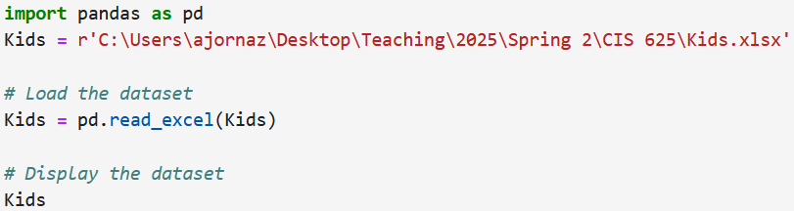
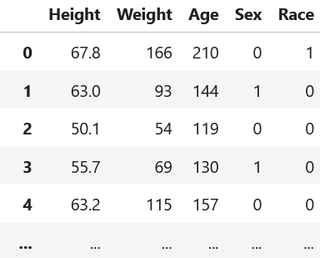
Import the dataset, and print out.

Slide 4
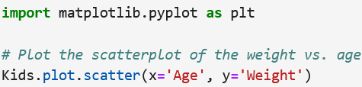
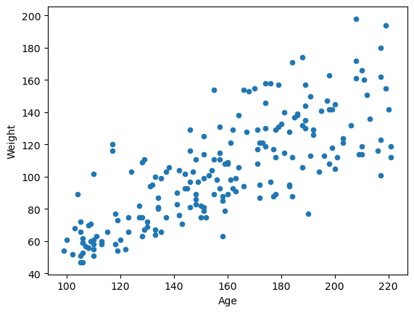
Figure 1 The scatterplot matrix of the weight vs. age
Using a scatterplot, describe the relationship between the weight and age.
There is a positive linear relationship between the weight and age.

Slide 5
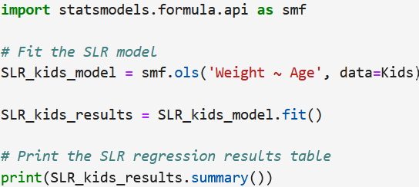
Fit a simple regression model to predict the kids’ weight.

Slide 6
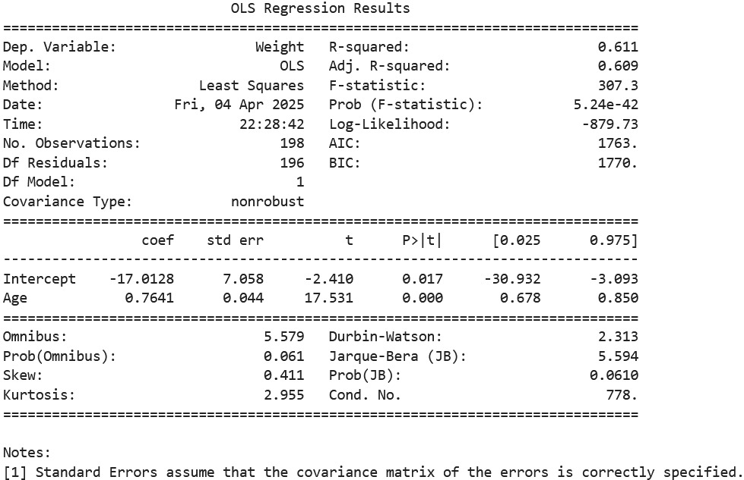
Table 1 The simple linear regression analysis results

Slide 7
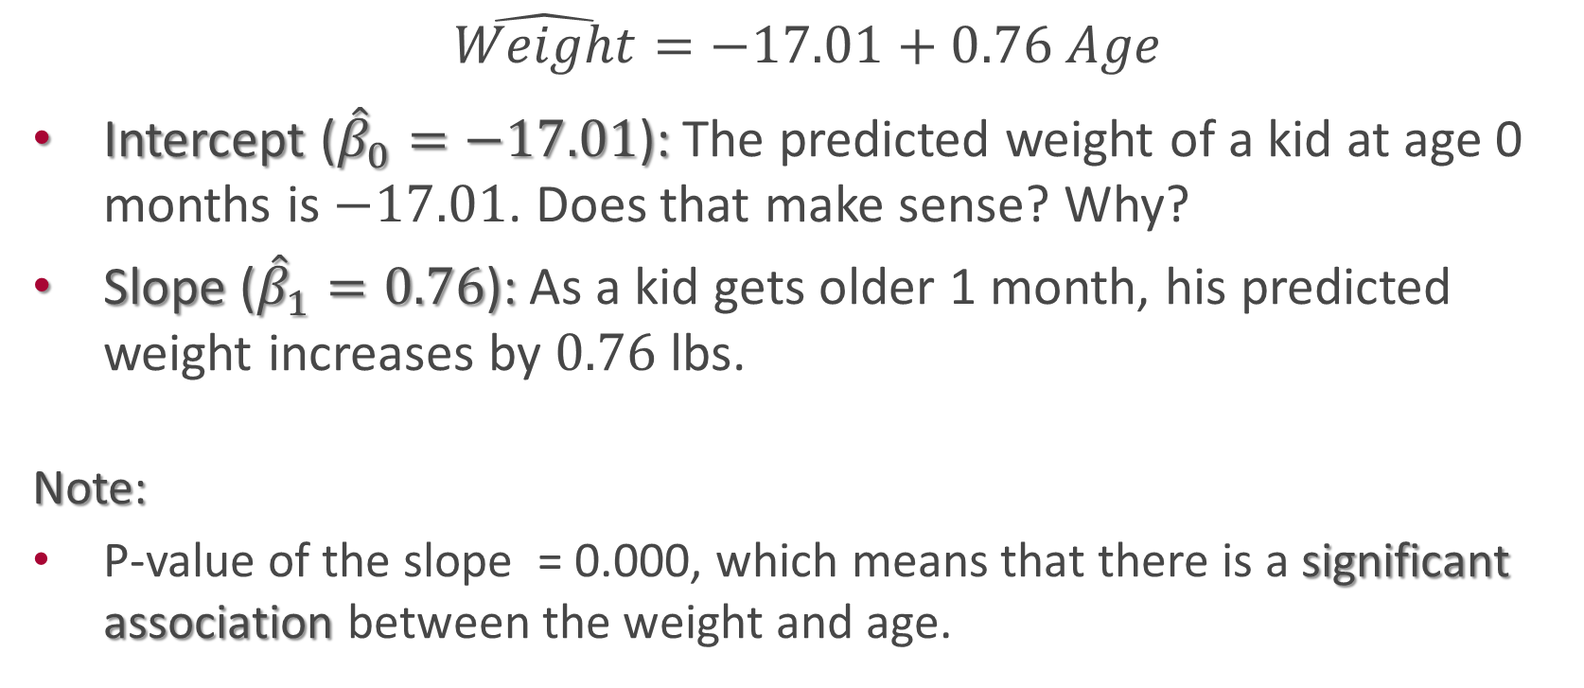
Interpret the regression model coefficients.
$$\hat{Weight}=−17.01+0.76 Age$$
Intercept (${\hat{β}}_{0}=−17.01$): The predicted weight of a kid at age 0 months is $−17.01$. Does that make sense? Why?
Slope (${\hat{β}}_{1}=0.76$): As a kid gets older 1 month, his predicted weight increases by $0.76$ lbs.
Note:
P-value of the slope = 0.000, which means that there is a significant association between the weight and age.

Slide 8
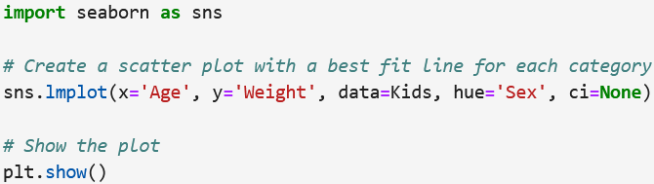
Graph the scatterplot with the best-fit lines for the weight vs. age based on sex.

Slide 9
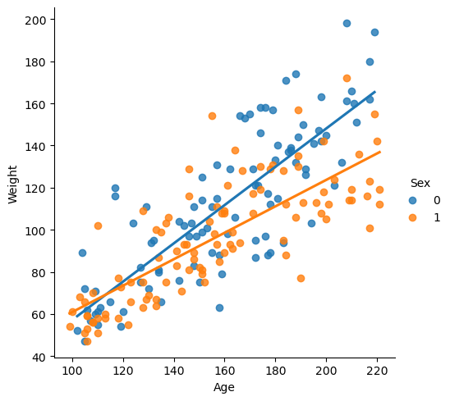
Figure 2 The best-fit lines for boys and girls
The graph shows that the boys’ slope (0) is greater than the girls’ slope (1), which means that the boys gain weight more than girls as they get older.

Slide 10
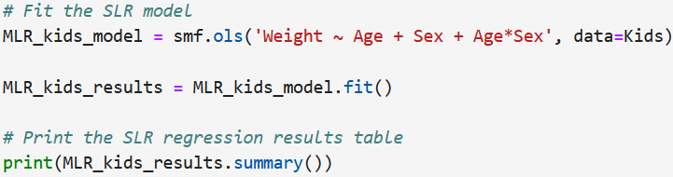
Fit a simple regression model to predict the kids’ weight based on age and sex (with interaction term).

Slide 11
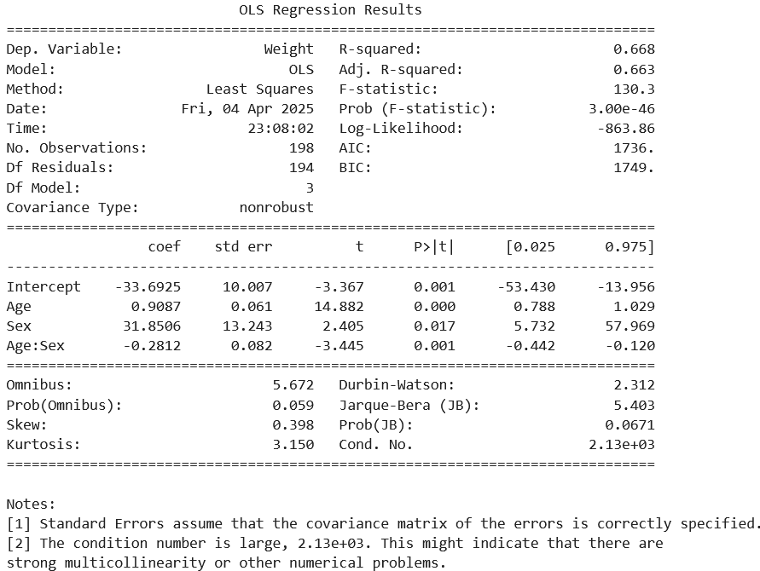
Table 2 The multiple linear regression analysis results

Slide 12
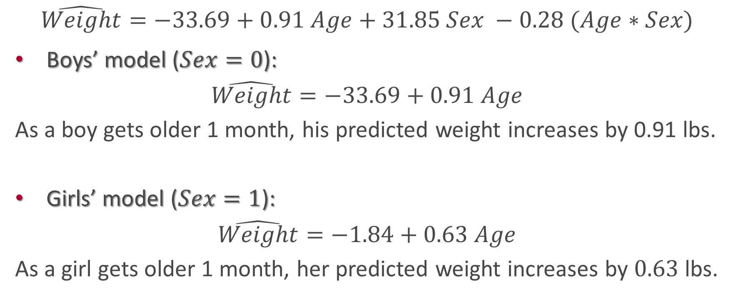
Interpret the regression model coefficients.
$$\hat{Weight}=−33.69+0.91 Age+31.85 Sex −0.28 (Age∗Sex)$$
Boys’ model ($Sex=0$):
$$\hat{Weight}=−33.69+0.91 Age$$
As a boy gets older 1 month, his predicted weight increases by 0.91 lbs.
Girls’ model ($Sex=1$):
$$\hat{Weight}=−1.84+0.63 Age$$
As a girl gets older 1 month, her predicted weight increases by $0.63$ lbs.

Slide 13
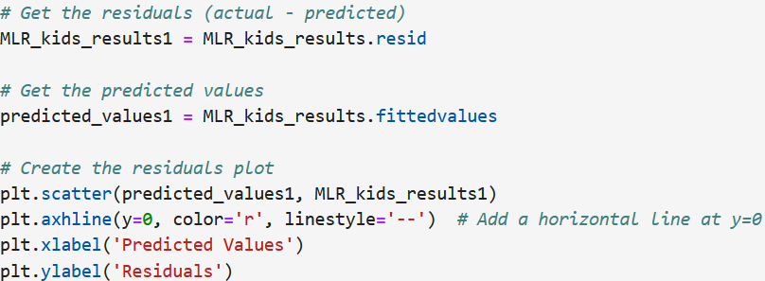
Check the regression assumptions.

Slide 14
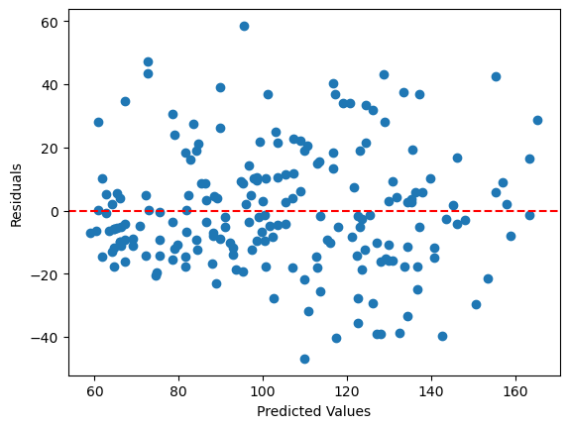
Figure 3 The residuals vs. predicted values plot
The graph shows that linearity, independence, and equal variance assumptions are met.

Slide 15
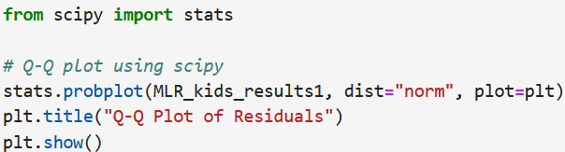
Checking the normality assumption.

Slide 16
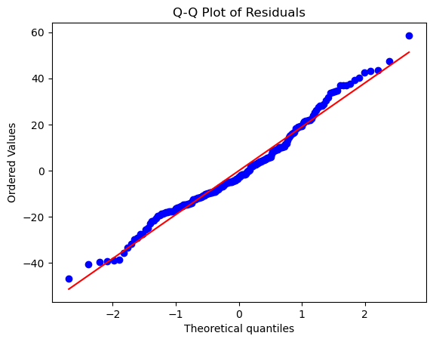
Figure 4 The qq-plot plot
The graph shows that normality assumption is reasonable.

Slide 17
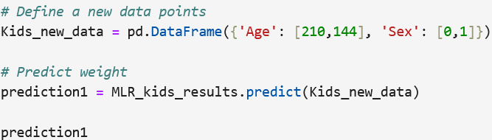

Using the multiple regression model, how much the predicted weight for a boy aged 210 months and a girl aged 144 months.
The predicted weight of a boy aged 210 (17.5 years) is 157.13 lbs, and the predicted weight of a girl aged 144 (12 years) is 88.52 lbs.

